Slide 1
Shared Community Health Needs Assessment (CHNA)
Creating The Story About Our Data
Penobscot County
Fall 2015/Spring 2016
Notes:
Welcome/Introductions
Recognition of sponsors, organizations providing space/refreshments/other resources
Some brief housekeeping details….bathrooms, cell phones, agenda
We are here as part of the mission of the Maine Shared Health Needs Assessment & Planning Process Project, also called Maine SHNAPP. Our mission is to create the framework and approach for a shared CHNA that [a] provides valuable population health assessment data to interested organizations and individuals, [b] supports public health accreditation efforts, and [c] addresses community benefit reporting needs of hospitals.
Ultimately, the Maine SHNAPP seeks to turn data into action and create the healthiest population in the USA.

Slide 2





Maine SHNAPP Funders
Notes:
This project is supported financially and with resources by the four largest hospital systems in Maine and the Maine CDC.
Brief history -- EMHS, MG, and MH worked together in 2010-11 to create the OneMaine Health Collaborative CHNA and the Maine CDC completed the 2012 SHA.
Statewide Coordinating Council for Public Health facilitated the conversation among Maine CDC/DHHS and hospital leaders to work together on a unified health needs assessment and community engagement process – resulting in the Maine SHNAPP & Shared CHNA.
This is the 1st state-wide public private partnership of its kind in the nation.

Slide 3

Setting the Stage for Our Story
Shared CHNA data tell a story
Data interpretation
Your role in the story
Pulling it all together
Notes:
We are here today to create the story about our data. This is how we begin to turn data into action. Set the stage….
“Shared CHNA data tell a story”
Data is more useful and interesting when it relates to our lives and our community.
Local = County
“Data interpretation”
The data we are reviewing come from different places; some from an online Stakeholders Survey (May-June 2015 among about 1,600 people in Maine from over 80 organizations and businesses), some from 25 sources including surveys, health data (in-patient and office visits), and disease registries.
“Your role in the story”
Data don’t tell the entire story.
Each of you play an important role in that you experience life here and have valuable insights into the health concerns of your neighbors, co-workers, family members, etc. There are things that affect where we live, play, learn, and work that affect our health, and you know about these too.
“Pulling it all together”
The story about our data comes from discussing the Shared CHNA, getting input from experts and community members alike, and using all of this information to develop health improvement plans.
Health improvement plans – called implementation strategies by hospitals – are documents that guide the focused actions of organizations. They are similar to strategic plans for businesses or lesson plans for teachers.

Slide 4


The Script
Notes:
Provide or reference the HANDOUT of the County/District Summary Data Sheet
Previous mention of data ≠ whole story; We are using the data as a script from that we interpret based on our experiences living, working, learning, and playing in this county/district
We know things about our families, neighbors, co-workers, students, customers, and patients that provide important context for the data
This is what we are here to share today…to begin the conversation.

Slide 5

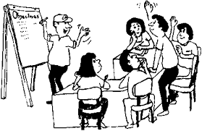


Our Task Today….
Notes:
We’ll be referring to our data summary sheets and stakeholder survey findings while we look at slides of certain health topics that affect most of us – either personally or someone we love, or through the work we do.
We’ll be looking at topics that affect a large number of us or that have significant differences between our area and the state as a whole.
Since we cannot look over all topics, we will focus on three that others have noted may be important for this county.
I’ve created a parking lot to track questions or issues we will not have time to address today. This will be shared with local leadership among a group we call the SHNAPP Community Engagement Committee (or whatever this group is called locally).
If someone has a question I cannot answer, it’ll go on the parking lot and the Maine SHNAPP Project Director will get a response. [Determine whether you as the presenter will be the go-between for questions or if you’ll share Jayne’s name and contact information to work with the person/people directly.]

Slide 6
Top health issues for Penobscot County
Stakeholder Survey – Total 1,639 surveys; Penobscot County 185 surveys
Source: Maine SHNAPP Stakeholder Survey, 2015
Notes:
We collected data from a bunch of sources, and we found that these three things were biggest health problems.
These are the top 3 health issues for Penobscot County based on information provided by the 185 respondents from this county on the Stakeholders Survey.
People who responded to the survey were asked to rank health issues on a scale of 1-5 where “1” was Not at all a problem and “5” was Critical problem. (“4” = Major problem)
The full report for the county identifies the top 5 health issues [reports are located at www.maine.gov/SHNAPP/]
The top 3 health issues for the state were:
Drug & Alcohol Abuse – 80%
Obesity – 78%
Mental Health – 71%

Slide 7
Top issues affecting where we live, work, learn & play in Penobscot County
Stakeholder Survey – Total 1,639 surveys; Penobscot County 185 surveys
Source: Maine SHNAPP Stakeholder Survey, 2015
Notes:
We collected data from a bunch of sources, and we found that these three things were the top reasons for bad health…..the top issues affecting where we live, work, learn, and play in Penobscot County based on information provided by the 185 respondents from this county on the Stakeholders Survey.
People who responded to the survey were asked to rank these issues on a scale of 1-5 where “1” was Not at all a problem and “5” was Critical problem. (“4” = Major problem)
The full report for the county identifies all of the issues [reports are located at www.maine.gov/SHNAPP/]
The top 3 factors for Maine were identified as:
Poverty – 78%
Access to Behavioral Care/Mental Health Care – 67%
Transportation – 67%

Slide 8

Quick look at data about drug & alcohol abuse, obesity, and physical activity & nutrition

Slide 9
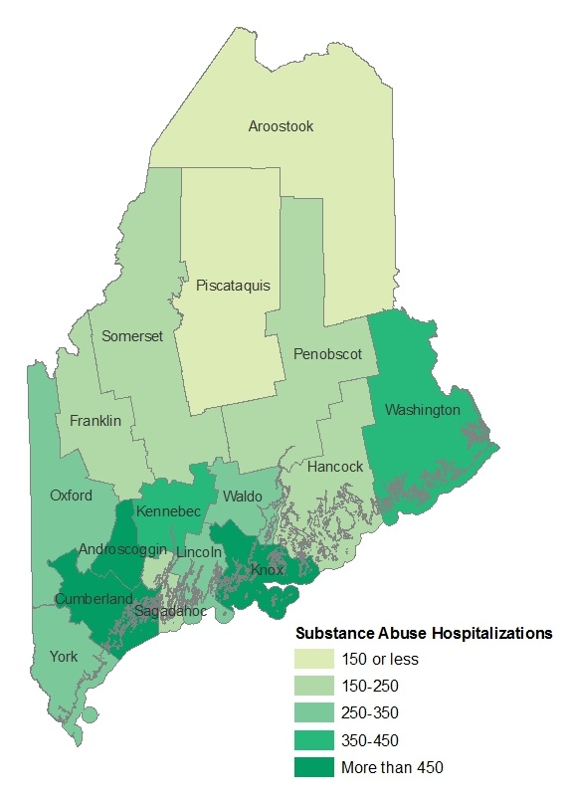
Drug & Alcohol Abuse
Penobscot County
Substance Abuse Hospitalizations by County
Penobscot
150 per 100,000
Maine
328 per 100,000
Per 100,000 population
Maine Shared Health Needs Assessment, 2015
Source: Maine Health Data Organization, 2011
Notes:
Now we will briefly take a look at the top 3 health issues. Let’s begin with Drug & Alcohol Abuse.
This map shows how all counties in Maine compare to each other on the # of hospital admissions for substance abuse.
There is a statistically significant difference between Penobscot County and Maine where Penobscot County is significantly lower than Maine at 150 vs 328 per 100,000 population; This is not measured at the national level.
Androscoggin, Cumberland, and Knox Counties have the highest rates (for the state) of SA hospital admissions – darker green.
Data is from 2011.

Slide 10
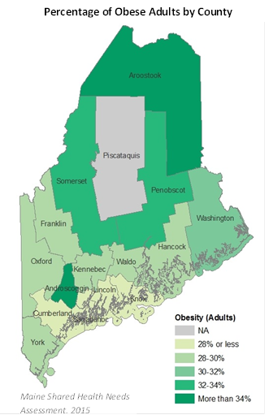
Obesity
Penobscot County
Penobscot
32%
Maine
29%
Source: Behavioral Risk Factor Surveillance System (BRFSS), 2013
Notes:
This map shows how all counties in Maine compare to each other on the % of obese adults. While the difference between the county and the state is not a lot, recall the graphic showing 1/3 of all people with obesity is a high percentage overall.
The data were not included for Piscataquis because the numbers of people answering this question were too low. Because of this issue with small numbers we’re working to expand the sample size in 2016.
Penobscot County is slightly higher than the Maine percentage (and higher than nationally @ 30%).
Stated differently, if we randomly selected 100 adults in Penobscot County, 32 of them would have obesity; If we randomly selected 100 adults across the state, 29 of them would have obesity
The darker green shows higher percentages of obesity among adults.
These data are from 2013.
Obesity defined via BRFSS U.S. Core – people self-report their height and weight which is used to calculate BMI those above 30 are considered obese.

Slide 11
Physical Activity & Nutrition
Penobscot County
Selected Measures of Physical Activity: Franklin County
Source for No physical activity in past month (adults): BRFSS (U.S. Core), 2013
Source for Met physical activity recommendations adults: BRFSS (U.S. Core), 2013
Source for Met physical activity recommendations high school students: MIYHS, 2013
Notes:
Some of the ways we look at physical activity include:
For Adults in Penobscot County, those who self-reported not engaging in physical activity in the past month was higher than Maine. This is (statistically) significant.
For Adults in Penobscot County, those who met physical activity recommendations was less than Maine.
BRFSS definition for adults physical activity recommendation :
For substantial health benefits, adults should do at least 150 minutes a week of moderate-intensity, or 75 minutes a week of vigorous-intensity aerobic physical activity, or an equivalent combination of moderate- and vigorous-intensity aerobic activity. Aerobic activity should be performed in episodes of at least 10 minutes
Adults should also do muscle-strengthening activities that are of moderate or high intensity and involve all major muscle groups on 2 or more days a week, as these activities provide additional health benefits
For Penobscot High School Students, less met the recommendations compared to the state of Maine (43% in Penobscot versus 44% in Maine)
MIYHS……CDC definition of recommendation for youth (6-17)
Children and adolescents should do 60 minutes (1 hour) or more of physical activity each day.
Include muscle strengthening activities, such as gymnastics or push-ups, at least 3 days per week as part of your child's 60 or more minutes
Include bone strengthening activities, such as jumping rope or running, at least 3 days per week as part of your child's 60 or more minutes.
These data are from 2013.

Slide 12
Physical Activity & Nutrition
Penobscot County
Source: Fruit Consumption among Adults 18+ (<1 serving per day): BRFSS (U.S. Core), 2013
Source: Vegetable consumption among Adults 18+ (<1 serving per day): BRFSS (U.S. Core), 2013
Source: Fruit & vegetable consumption (High School Students): MIYHS, 2013
Notes:
In Penobscot County, the self-reported fruit and vegetable consumption was higher for adults compared to Maine.
There is a statistically significant difference between Penobscot County and Maine for high school students consumption of fruit and vegetables where it is statistically lower than Maine (14% versus 17% respectively).
These data are from 2013.

Slide 13

2 Minute Data Review
Notes:
Please take 2 minutes to look over your handout: Summary Data for Penobscot County.
You’ll notice the column for our county, Maine, and USA to show comparisons. Numbers in the county column that are highlighted and italicized are statistically significant, meaning the difference did not happen by chance. But also notice numbers that are higher or lower than the state and look at the trend arrows to see how things are changing over time.
Presenter [or someone identified as timekeeper] should watch time.

Slide 14

Creating The Story About Our Data
Significant health issues
Health priorities
Resources to address health issues
Perceptions about things where we live, work, learn, and play that affect our health
Notes:
Edit this slide to include bullets for only the 1-2 questions you’ll have time to ask this group. It may be helpful to write their responses on paper posted to the wall.
Acknowledge the limited time and place items/questions for further discussion in the parking lot. Let group members know the parking lot will be shared with the local SHNAPP Community Engagement Committee contacts (listed on the next slide). Encourage motivated community members to seek these people out for further discussion….segue to next slide
Ideas for questions:
-We’ve looked briefly at data for our county. Based on your experience living here and quickly looking over these numbers, what would you say are significant health needs for our community?
-What would you say are the highest priorities among health needs for this county (or community)?
-What resources or assets are you aware of locally that could address our health needs?
-What do you think are the reasons for some of the poor health outcomes (name issues or priorities noted by this group as examples)? If the group needs prompting, remind them of the Stakeholders Survey issues: Transportation, Health Care Insurance, Health Literacy. [Contact Jayne Harper for a full list of the health factors affecting where we live, work, learn, and play that were included in the Stakeholders Survey.]

Slide 15

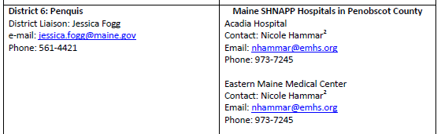
I’d like to continue the conversation about the
Shared CHNA…..
Maine Shared Health Needs Assessment & Planning Process Contacts for Community Engagement – District Liaisons & SHNAPP Hospitals
Shared CHNA Reports: www.maine.gov/SHNAPP/
Notes:
Add local contacts
Recommendation – print this slide as a Handout for participants
Remind participants they can provide input & feedback at the website listed here. All comments are welcome.

